Slide 1

DS 51000
Reilly, Said, Sydney and Max

Slide 2
Project Scenario
Brief Introduction About the data set
Olympics
https://olympics.com/en/olympic-games/tokyo-2020/medals
GDP
https://www.worldometers.info/gdp/gdp-by-country/
Kaggle Integration
https://www.kaggle.com/arjunprasadsarkhel/2021-olympics-in-tokyo?select=Teams.xlsx

Slide 3
Dataset Introduction
Pandas Dataframe to csv
https://github.com/hyunsukr/DS5100-Final/tree/main/data
Dimension
Tokyo Olympics: 74 x 14
Historical Olympics: 1315 x 9
Data was webscrapped and engineered to produce a final dataframe with the information below.

Slide 4
Dataset Web Scraping
Class called Web_Scrapper
Three data sets were webscrapped
Olympics
GDP
Only gives 2020 (recent GDP)
GDP Historical Data

Slide 5
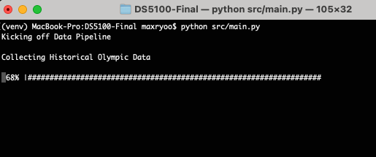
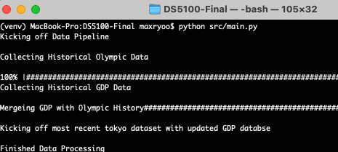
Data Processing - Interaction
Interaction with user
Progress bar to show % data pull
Give feedback to user how much the data pull is complete.

Slide 6
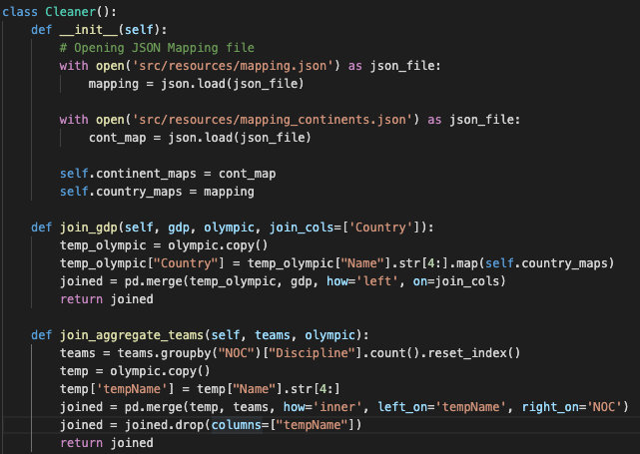
Data Processing - Data Engineering
Joined datasets based on country name
Some country names were different
Had to map countries names through a json (dictionary) through data cleaning
Added geographical location for the data
Continents each country is located
Utilized a third party package
pycountry-convert

Slide 7
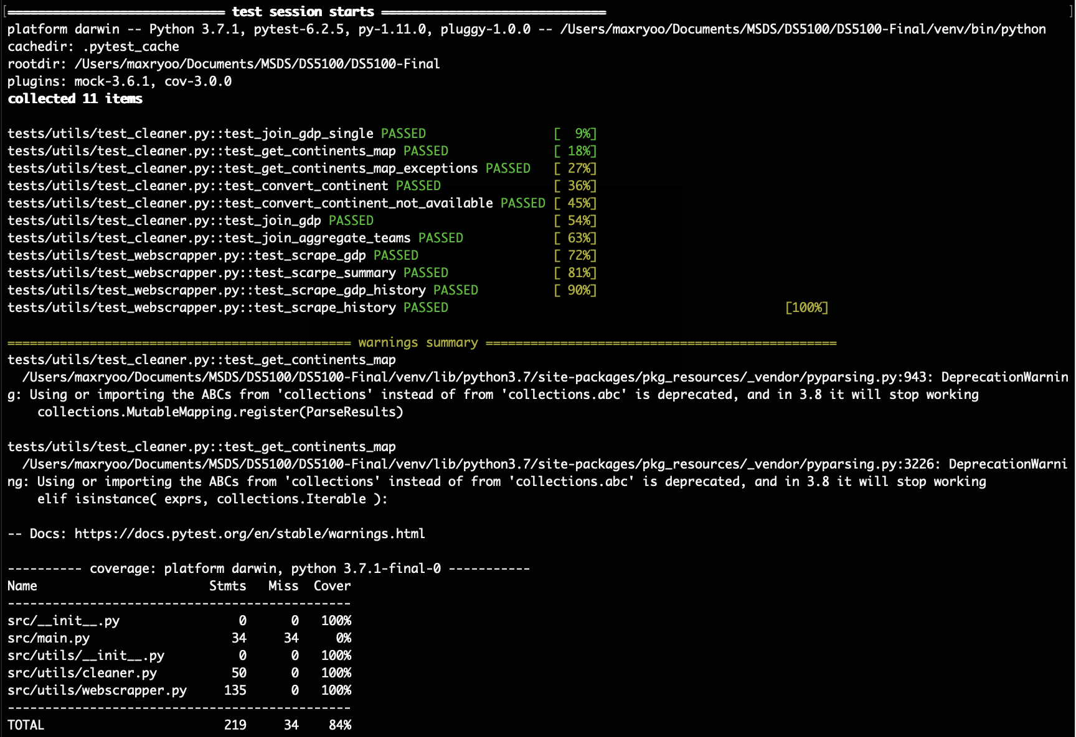
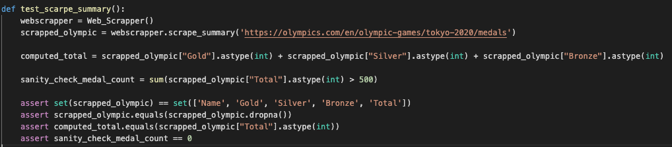
Testing
Pytest to test the code / coverage
Data engineering functions and data quality testing
All methods relating to data
Code coverage of 100% except main

Slide 8
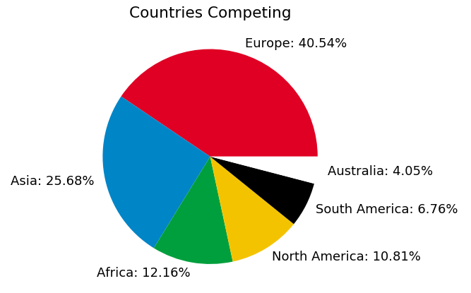
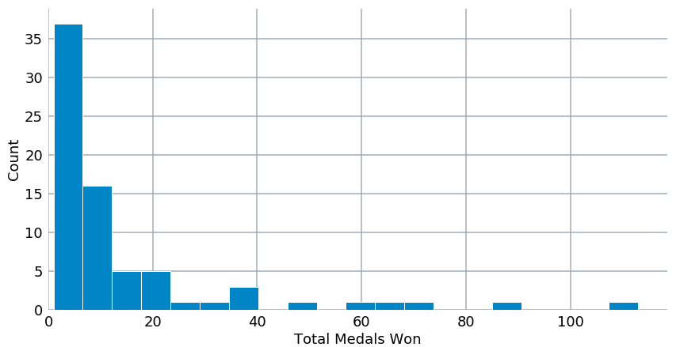
Exploratory Data Analysis

Slide 9
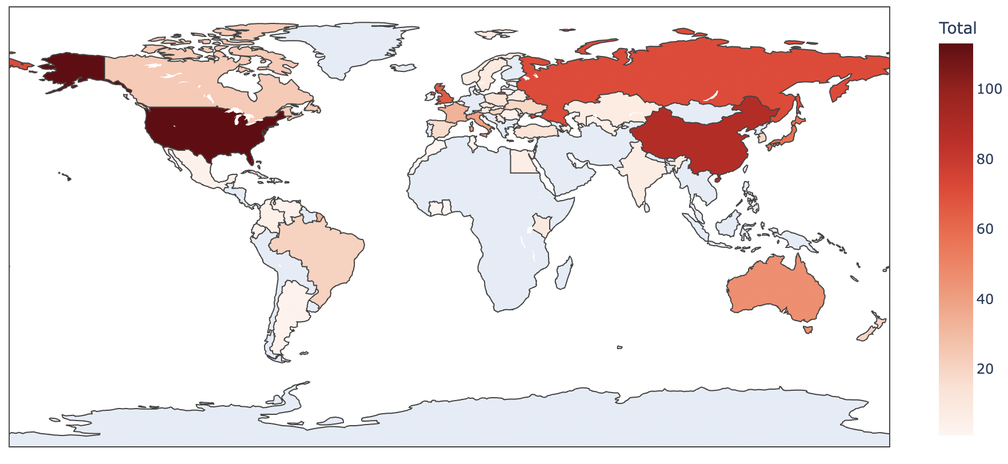
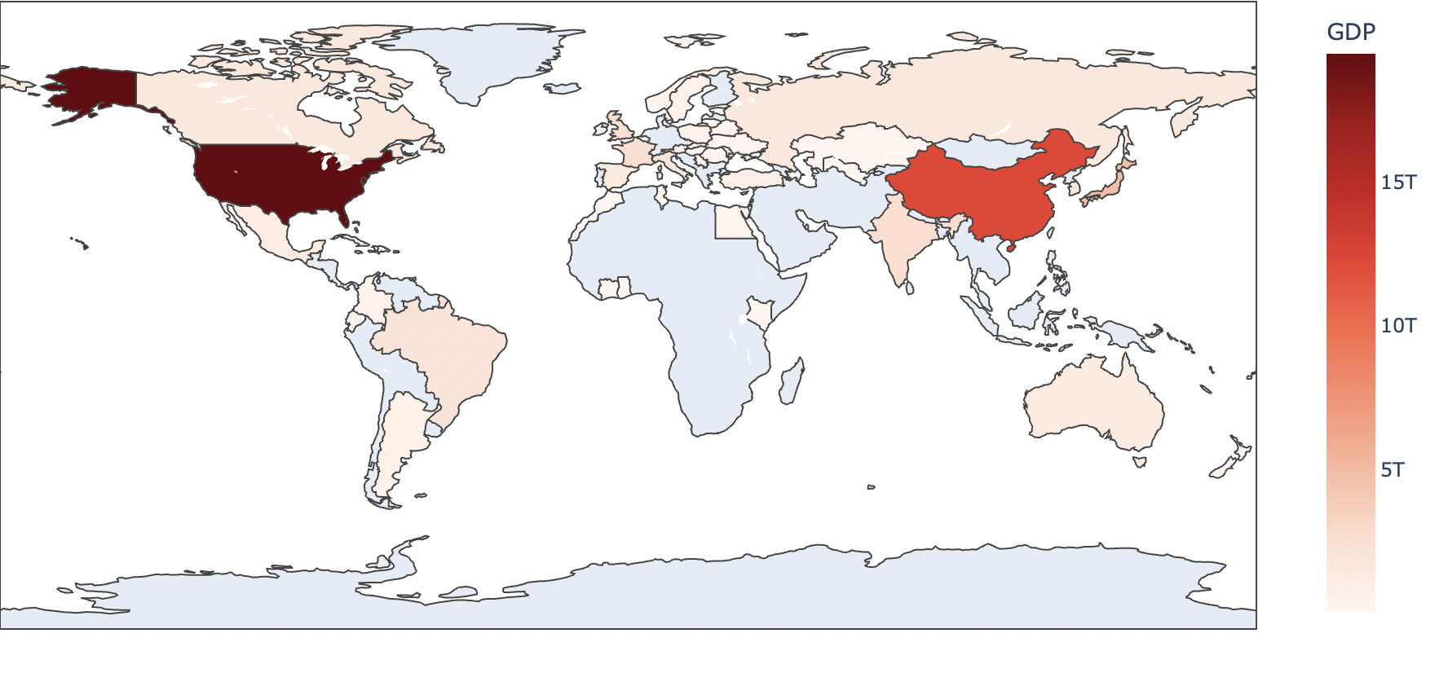
World Statistics
Conclusions:
US has highest GDP and number of medals won
China second for both
Relationship not as strong for rest of world
Russia, Australia, & Great Britain have high medal counts but lower GDPs compared to US and China

Slide 10
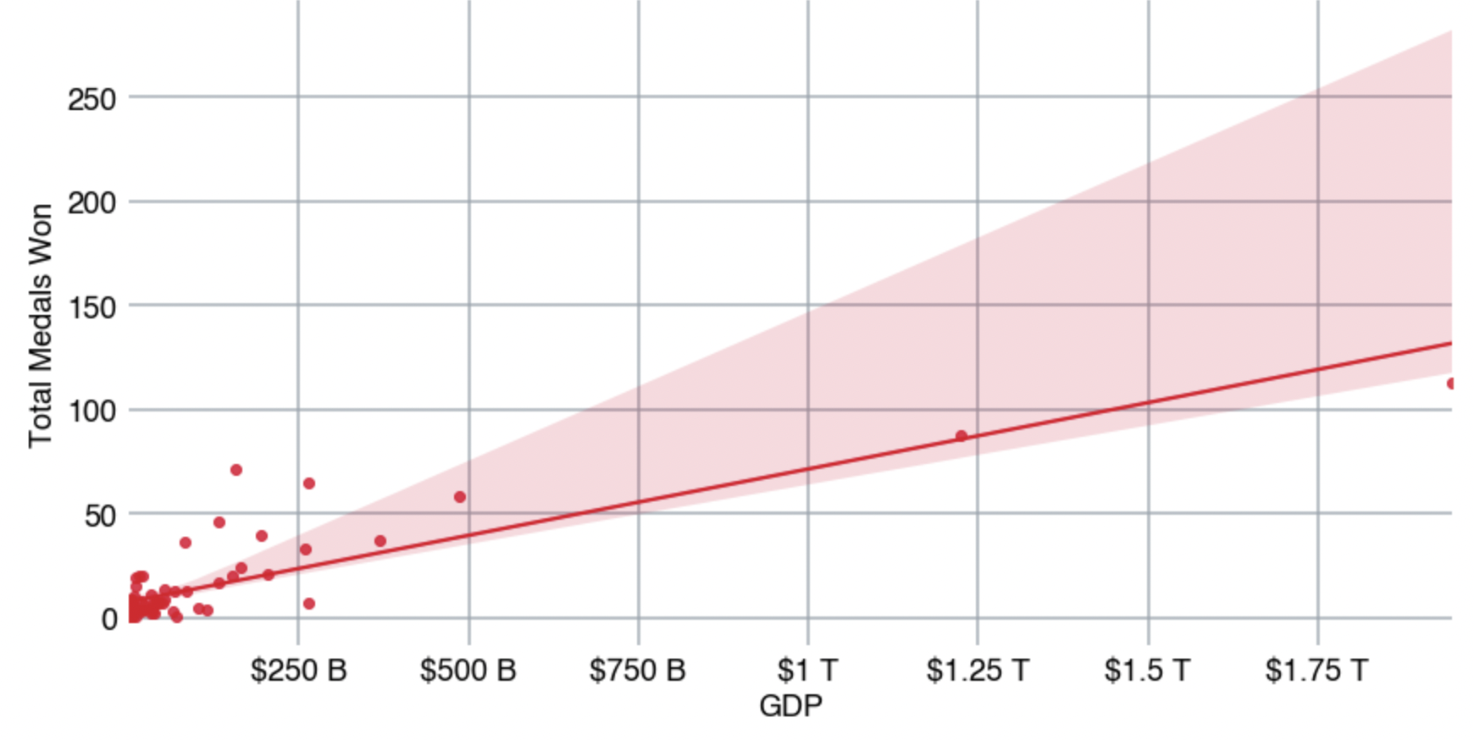
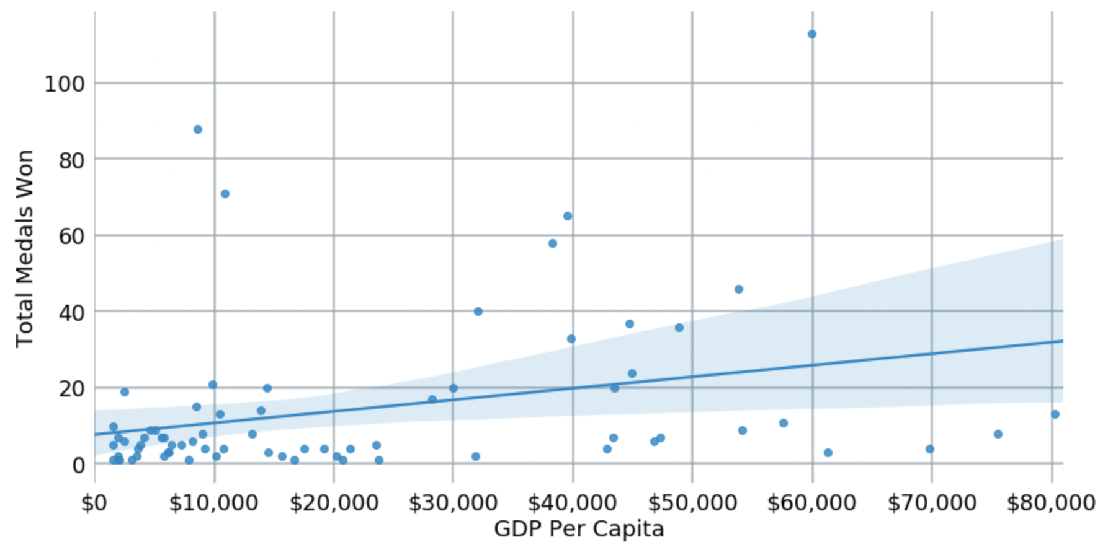
Medal Count versus GDP
Conclusion: The relationship between GDP and medals won is much stronger than the relationship between GDP per capita and medals won.

Slide 11
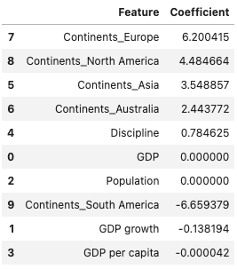
Model Building
Multiple Linear Regression
R^2 = 0.8479990568528668
Mean Squared Error = 109.1391895919251
Root Mean Squared Error = 10.446970354697342
Possible Next Steps
Multicollinearity
Linear Regression assumption checking
GDP and Population had a beta of 0, which may raise eyebrows

Slide 12
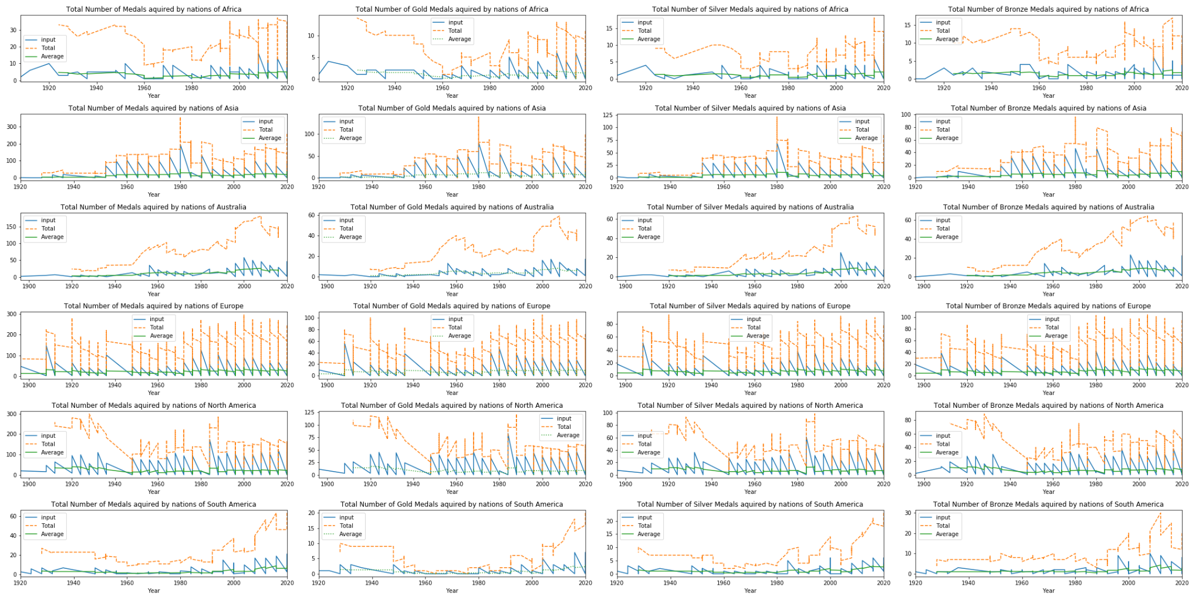
Time Series Analysis
Historical data was pulled from the olympics website through web scraping.
Summer olympics from Tokyo 2020 - Athen 1896

Slide 14
Conclusion / Next Steps
Code in github is available with virtual environments
Making the github repo a package repo will make it so that we can deploy the package.
Setup.py
Dive deeper in the Multiple Linear Regression model such as multicollinearity etc.

